Slide 1
Storytelling
Multimodal Storytelling
Imitation learning by generative adversarial nets
multimodal learning
Graph modeling (ref.pdf)
spectral graph theory + approximation theory
entity/relation application

Slide 2
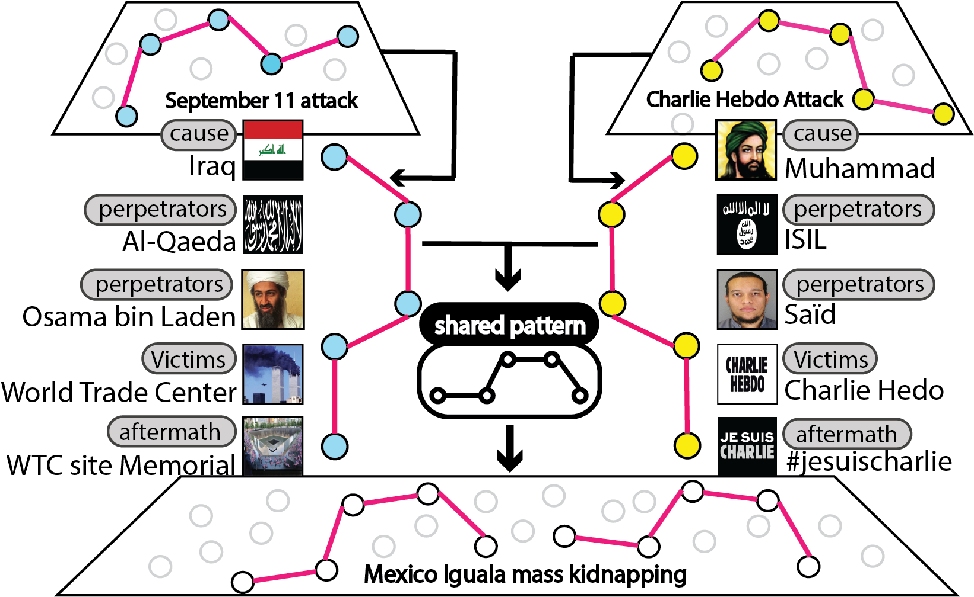
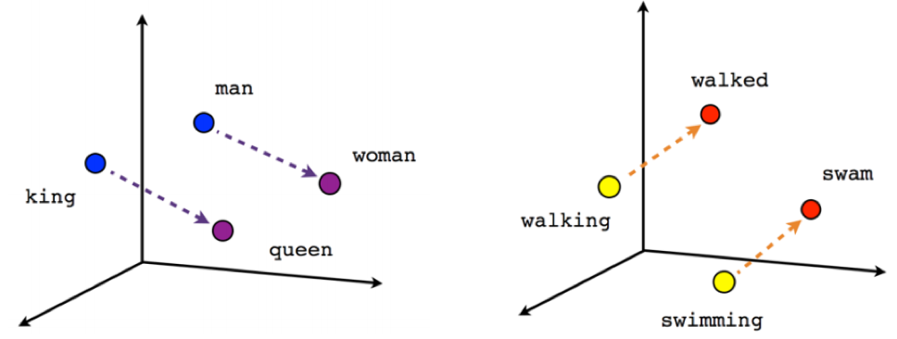
Intuitive example [ story pattern ]
similar storylines share the similar structure in a embedding space
[king] - [man]
=
[queen] - [woman]
cause -> attacker -> victims -> aftermath

Slide 3
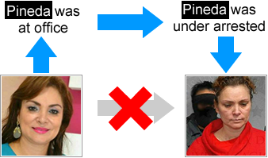
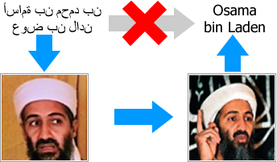
Intuitive example [ multimodal info ]
Multimodal data
humans often make inferences between the images and texts so as to resolve ambiguities.
connect img by txt
connect txt by img

Slide 4
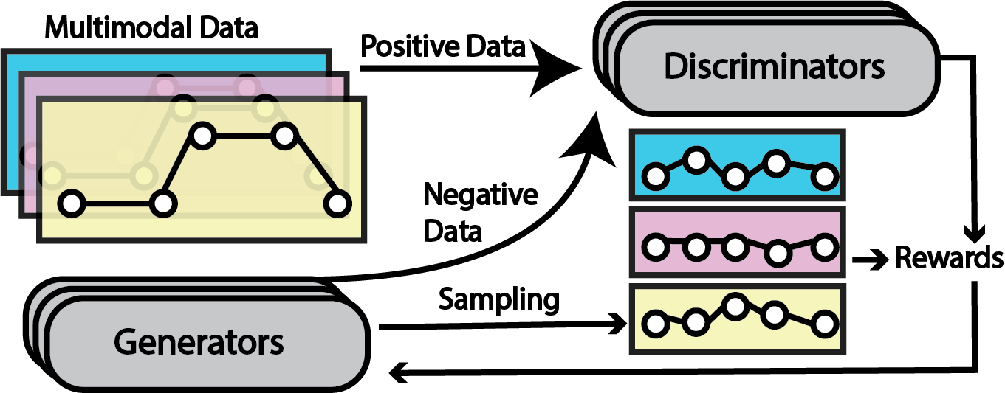

Method
input: User-provided storylines
TextCNN
4
2
1
3
Multimodal policy gradient
LSTM
output: Generated storylines
multiple modalities

Slide 5
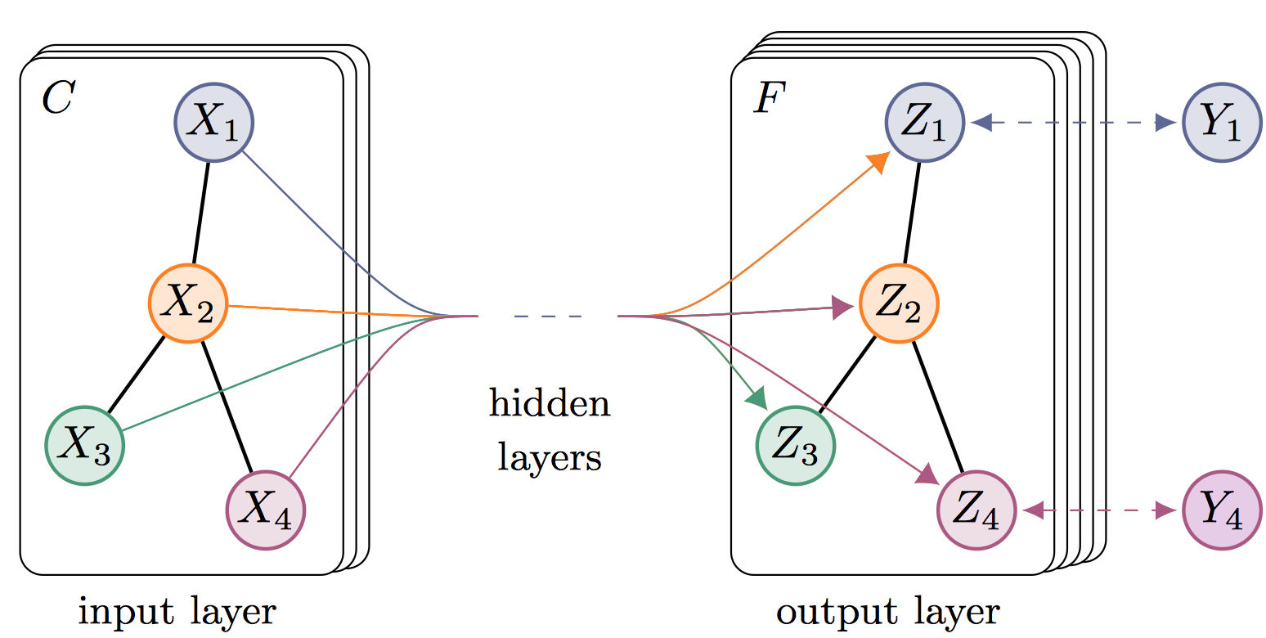
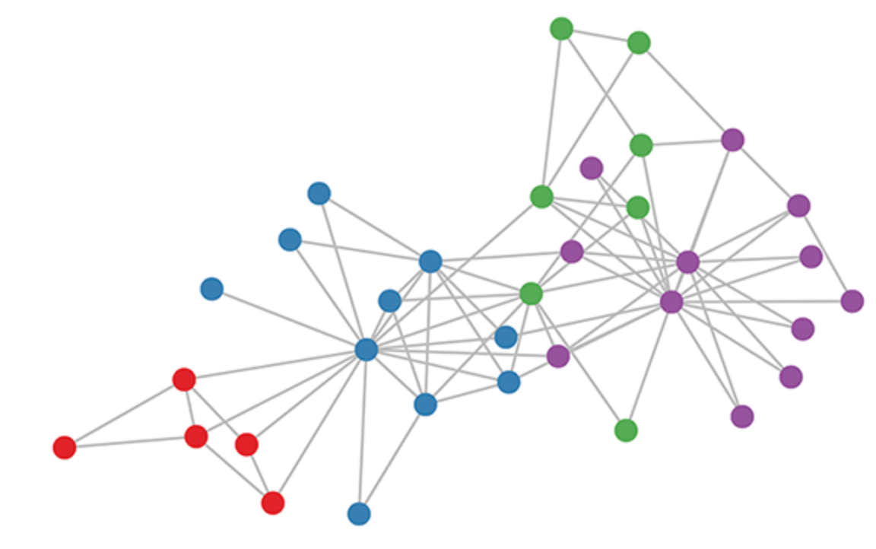
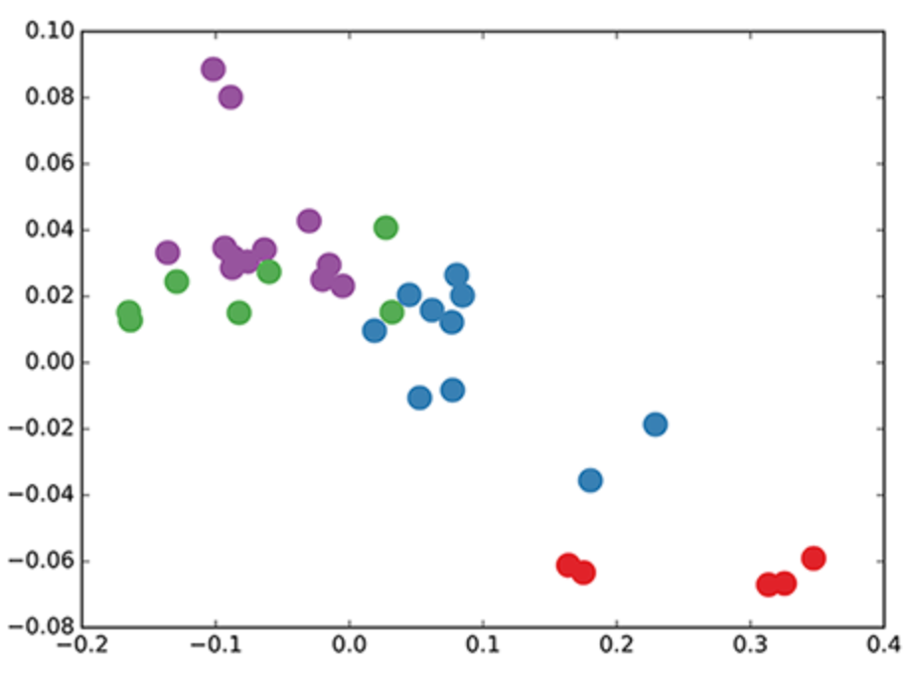
Graph CNN
Motivation: Capture graph structure is complex; CNN is very successfully in image(grid) domain; graph is similar to image.
We expect it to be powerful in scenarios where the adjacency matrix contains information not present in the entity node X
Graph structure(adjacency matrix) in freq + node feat -> new node feat
To avoid the high complexity of eigenvalue decomposition, Chebyshev polynomials is applied to approximate the true values
The 3-layer GCN now performs three propagation steps during the forward pass and effectively convolves the 3rd-order neighborhood of every node (all nodes up to 3 "hops" away). Remarkably, the model produces an embedding of these nodes that closely resembles the community-structure of the graph

Slide 6
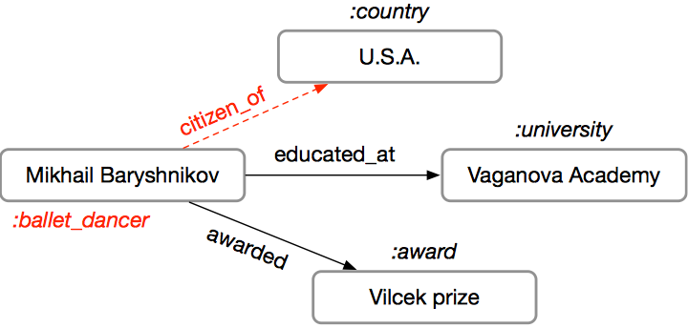
Modeling Relational Data with GCN
Motivation
consider relation and entity classification at the same time
Example:
Entity helps relation
Vilcek prize (an award honoring contributions of immigrants to the US society) implies having the US citizenship
Relation helps entity
graduating from the Vaganova Academy probably means that the entity is a ballet dancer.

